Slide 1
Hot Topics in Economic Journals
Nathanael &
Anna-Katharina

Slide 2
Motivation and Theoretical Background
strong criticism of “mainstream economics” after 2008
broad debate about the status quo of economics
different dimensions of the debate - our focus: journal topics

Slide 3
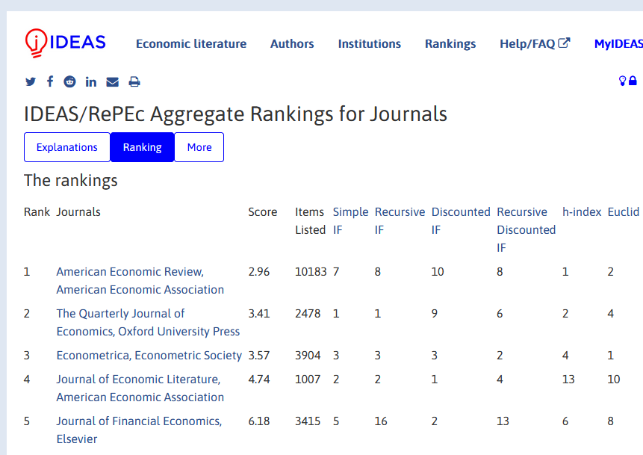
Journals in Economics
very clear/public ranking

Slide 4
Journals in Economics
very clear/public ranking
not a level playing field

Slide 5
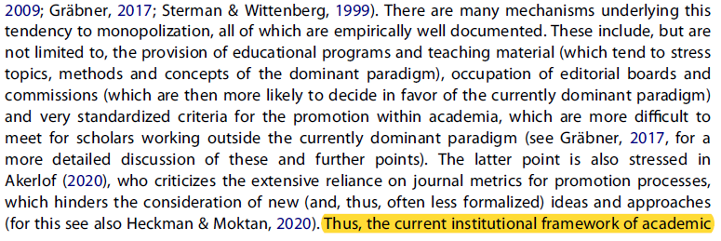
Journals in Economics
Claudius Gräbner & Birte Strunk (2020) Pluralism in economics: its critiques and their lessons, Journal of Economic Methodology, 27:4, 311-329, DOI: 10.1080/1350178X.2020.1824076

Slide 6
Journals in Economics
very clear/public ranking
not a level playing field
focus on specific topics and methodologies

Slide 7
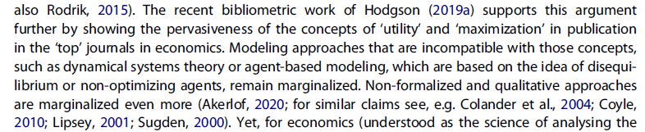
Journals in Economics
Claudius Gräbner & Birte Strunk (2020) Pluralism in economics: its critiques and their lessons, Journal of Economic Methodology, 27:4, 311-329, DOI: 10.1080/1350178X.2020.1824076

Slide 8
Journals in Economics
Theoretical finding:
Articles in the top-five journals are strongly pre-selected
beyond “reasonable” selection criteria, such as scientific quality or having to do with economics.
This selection of topics is stable over time
regardless of criticism and debate from outside (and inside!) the discipline

Slide 9
Hypothesis
H₀: There is high similarity between topics in the three highest-ranked journals.
H₁: There is little similarity between topics in the three highest-ranked journals.
Test: a small models captures the texts better than a big model
<=> a big model is worse than a small model
<=> a small number of topics is optimal (e.g. 5)

Slide 10
Hypothesis
H₀: There is high similarity between topics in the three highest-ranked journals.
H₁: There is little similarity between topics in the thre highest-ranked journals.

Slide 11
Method
Data:
  20.000 full text papers from American Economic Review 1945 - 2010
  9.000 tites from three higher-ranked journals 1990 - 2020 (American Economic Review, Econometrica, Review of Economic Studies)
Topic Model on the 20.000 papers
  First run with a 10 topic-model
  optimizing the model (k)
Structural Topic Model on the 9.000 titles
  optimizing the model (k)
  structured by year with optimal k

Slide 12
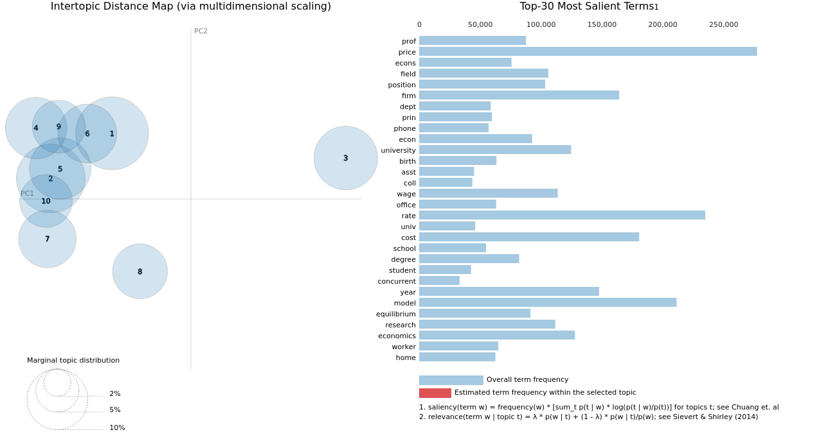
Test Results
Notes:
TOPIC 0
----------
- price (0.02488868124783039)
- cost (0.012594294734299183)
- market (0.009655710309743881)
- firm (0.007281667087227106)
- demand (0.0054245456121861935)
- function (0.004770212806761265)
- case (0.004515648819506168)
- profit (0.004373779520392418)
- would (0.004270883742719889)
- production (0.003964547999203205)
TOPIC 1
----------
- model (0.006787044927477837)
- health (0.005538872443139553)
- equilibrium (0.005475304555147886)
- choice (0.004841622430831194)
- game (0.004730726592242718)
- effect (0.004445378202944994)
- child (0.004338045604526997)
- state (0.004209340550005436)
- result (0.004199802875518799)
- player (0.004099318291991949)
TOPIC 2
----------
- would (0.008990769274532795)
- rate (0.0073759956285357475)
- cost (0.006951844785362482)
- income (0.0062089357525110245)
- government (0.005374025087803602)
- state (0.004972976632416248)
- year (0.004443030338734388)
- public (0.004390955902636051)
- cent (0.004147964995354414)
- market (0.004061923362314701)
TOPIC 3
----------
- percent (0.007648089434951544)
- effect (0.0074086436070501804)
- result (0.005245342385023832)
- table (0.0048288884572684765)
- group (0.004709798842668533)
- data (0.004257712047547102)
- model (0.004242262337356806)
- level (0.0041582416743040085)
- household (0.004153131507337093)
- time (0.003996678162366152)
TOPIC 4
----------
- wage (0.012246526777744293)
- firm (0.012221546843647957)
- labor (0.009268202818930149)
- worker (0.007856915704905987)
- model (0.007541189901530743)
- industry (0.006270057521760464)
- data (0.006264366675168276)
- change (0.006226807367056608)
- effect (0.00617651641368866)
- cost (0.006059706211090088)
TOPIC 5
----------
- economic (0.013939539901912212)
- theory (0.005813450086861849)
- policy (0.005741532426327467)
- country (0.0050705852918326855)
- price (0.004402105696499348)
- problem (0.004377559758722782)
- american (0.004253688734024763)
- would (0.0042502195574343204)
- book (0.004059196915477514)
- trade (0.004044228699058294)
TOPIC 6
----------
- rate (0.015969447791576385)
- model (0.010070309042930603)
- income (0.008389928378164768)
- price (0.008103902451694012)
- change (0.006611226126551628)
- policy (0.006600101012736559)
- inflation (0.00617467425763607)
- money (0.005918729584664106)
- real (0.0058100298047065735)
- data (0.005647752899676561)
TOPIC 7
----------
- field (0.016539882868528366)
- prof (0.01575462520122528)
- position (0.015387563034892082)
- econs (0.013925844803452492)
- econ (0.013340680859982967)
- state (0.01272835023701191)
- prin (0.010797195136547089)
- dept (0.010728530585765839)
- research (0.010594396851956844)
- degree (0.010490578599274158)
TOPIC 8
----------
- university (0.015469672158360481)
- year (0.011177054606378078)
- economics (0.010802904143929482)
- school (0.009983762167394161)
- economic (0.00911447312682867)
- student (0.0077379378490149975)
- american (0.006572498008608818)
- professor (0.0058287265710532665)
- college (0.005481473170220852)
- percent (0.005056528840214014)
TOPIC 9
----------
- capital (0.008941526524722576)
- firm (0.008778329938650131)
- price (0.00876238290220499)
- rate (0.0073564122430980206)
- equilibrium (0.007131944410502911)
- value (0.006846046540886164)
- model (0.0064161731861531734)
- market (0.00614728219807148)
- investment (0.0058933463878929615)
- period (0.005299404263496399)

Slide 13
Top words for each topic
Topic 1 Top Words:
Highest Prob: models, estimation, investment, dynamic, identification
FREX: instrumental, nonparametric, estimation, models, poverty
Lift: distribution-free, self-consistency, concave, gasian, hypothesis-testing
Score: models, estimation, nonparametric, identification, instrumental
Topic 2 Top Words:
Highest Prob: theory, exchange, evidence, networks, trading
FREX: r, trading, intermediation, sticky, d
Lift: alcohol-consumption, bureaucratic, episode, ethiopian, extremists
Score: theory, exchange, evidence, networks, trading
Topic 3 Top Words:
Highest Prob: evidence, data, health, effect, insurance
FREX: field, adoption, survey, child, experiment
Lift: 2003-2013, affordable, blame, blended, board's
Score: evidence, data, health, experiment, insurance
Topic 4 Top Words:
Highest Prob: model, economic, economics, american, development
FREX: hundred, january, association, proceedings, foreword
Lift: 7-9, 4-6, editor's, eighteenth, eighth
Score: model, economic, january, proceedings, hundred
Topic 5 Top Words:
Highest Prob: policy, evidence, rates, fiscal, government
FREX: interest, historical, policy, government, divorce
Lift: athletes, athletics, facet, inefficacy, intercollegiate
Score: policy, evidence, government, rates, fiscal
Topic 6 Top Words:
Highest Prob: information, games, learning, public, bargaining
FREX: private, games, repeated, bargaining, coordination
Lift: hindsight, insight, small-market, experimental-analysis, one-sided
Score: information, games, learning, public, bargaining
Topic 7 Top Words:
Highest Prob: approach, political, efficient, economy, money
FREX: applications, money, exclion, power, two
Lift: 1930-52, aftermarkets, antiracism, billionaires, celestial
Score: political, approach, money, economy, power
Topic 8 Top Words:
Highest Prob: risk, monetary, states, united, new
FREX: united, states, monetary, labor-market, union
Lift: 1748-1811, alcoholism, became, bombshell, certified
Score: risk, monetary, united, states, new
Topic 9 Top Words:
Highest Prob: income, consumption, hoehold, great, distribution
FREX: recession, heterogeneity, great, income, consumption
Lift: brides, prostitutes, truthfulness, refunds, decision-theoretic
Score: income, consumption, great, cycles, heterogeneity
Topic 10 Top Words:
Highest Prob: optimal, choice, testing, economics, tests
FREX: distinguished, fellow, society, president, econometric
Lift: undergraduates, anthony, comstock, got, griswold
Score: optimal, society, tests, report, econometric
Topic 11 Top Words:
Highest Prob: growth, capital, trade, international, wage
FREX: technological, human, capital, growth, sovereign
Lift: conclions, cross-group, difficulty, regarding, respondents
Score: growth, capital, international, time, wage
Topic 12 Top Words:
Highest Prob: effects, comment, school, long-run, treatment
FREX: comment, willingness, schools, accept, average
Lift: american-economic-review, at-and-t, aunts, averages, awards
Score: effects, comment, treatment, school, long-run
Topic 13 Top Words:
Highest Prob: effects, macroeconomic, vol, pg, understanding
FREX: pg, vol, police, fixed, electoral
Lift: 50-50, applying, article, audience, coachable
Score: effects, vol, pg, macroeconomic, relative
Topic 14 Top Words:
Highest Prob: market, markets, social, labor, asset
FREX: market, asset, security, labour, liquidity
Lift: positioning, accession, burst, clobber, acting
Score: market, markets, social, asset, search
Topic 15 Top Words:
Highest Prob: selection, reply, analysis, empirical, welfare
FREX: selection, adjtment, reply, persistence, inflation
Lift: multicomponent, confidence-enhanced, retail-grocery, mysteries, peter
Score: selection, reply, empirical, analysis, welfare
prob
matrix of highest probability words
frex
matrix of highest ranking frex words
lift
matrix of highest scoring words by lift
score
matrix of best words by score

Slide 14
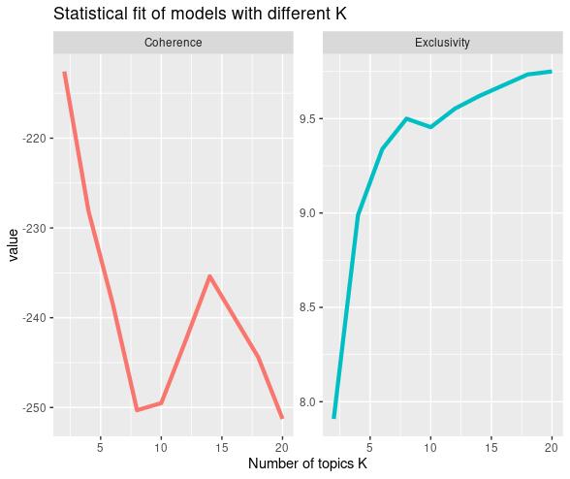
Testing K
Semantic Coherence: tells you how coherent topics are, i.e., how often features describing a topic co-occur and topics thus appear to be internally coherent.
Exclusivity: tells you how exclusive topics are, i.e., how much they differ from each other and topics thus appear to describe different things.

Slide 15
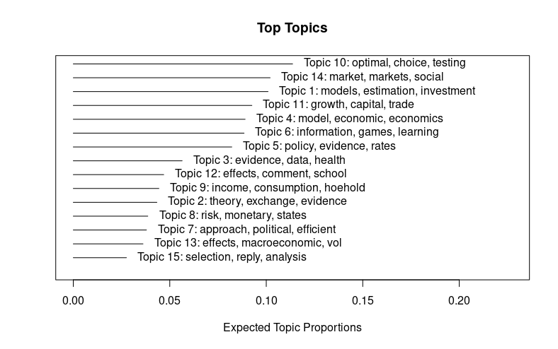
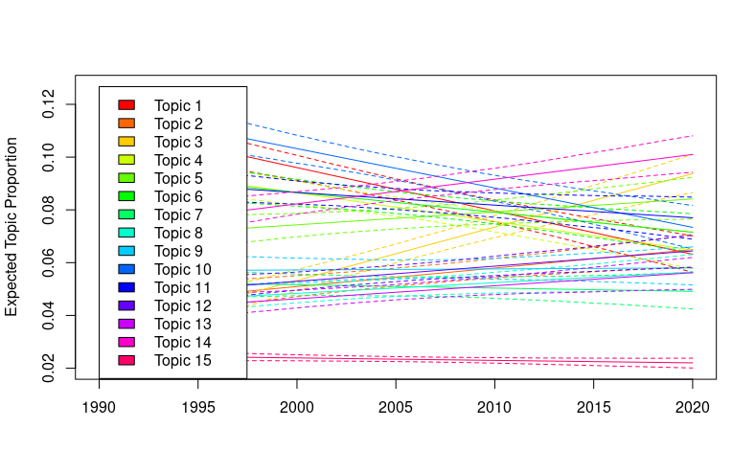
Results

Slide 16
Conclusion
MORE WORK IS NEEDED
Code: https://github.com/natesheehan/economic_topic_models
Thank you for your attention!

